Slide 1
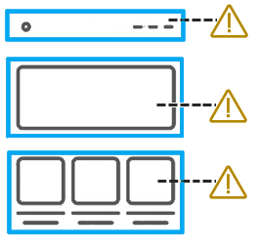

April 12, 2023
Understand
Test
Solve
STRUCTURE

Slide 2
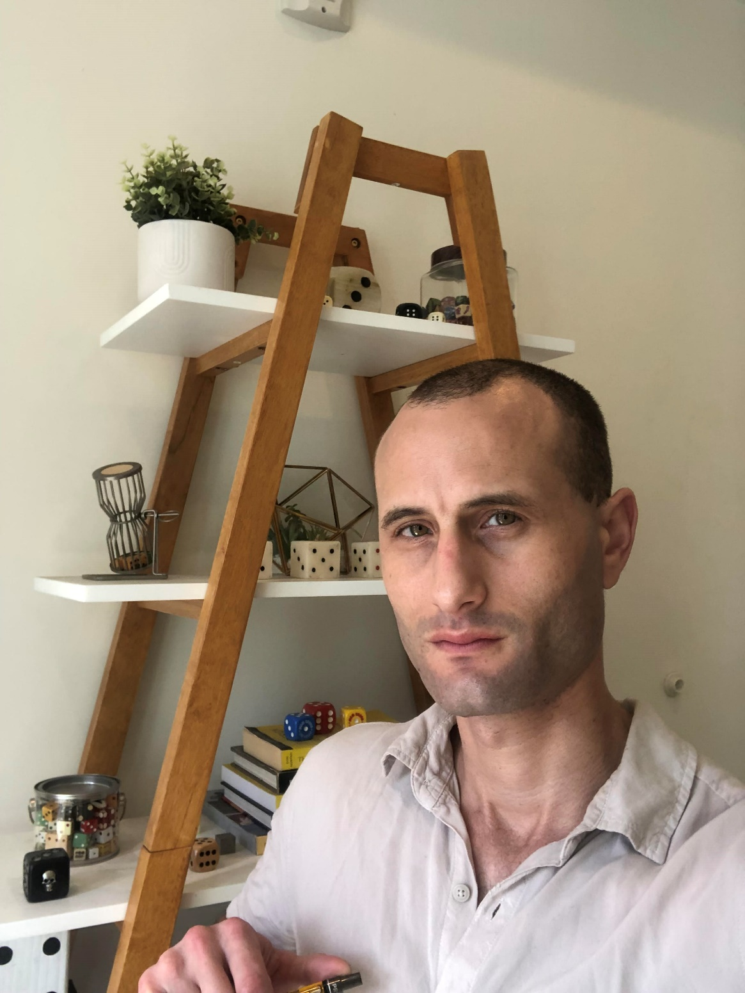
Aaron Farber
2016: Change careers from public policy to tech. Attend App Academy.
2017-2019: Run accessibility testing/development shop focused on small businesses
2019-2020: TPGi - Accessibility Engineer
2021: TPGi - Embedded with large tech company
2022: TPGi – Accessibility Platform Consultant
Notes:
2019: Web Accessibility Specialist
2020: Certified Professional in Accessibility Core Competencies
IAAP: International Association of Accessibility Professionals

Slide 3
Agenda
Plan For Testing
How Assistive Technologies Work
Headings
Landmarks
Links
Reading Order

Slide 4
Our Philosophy
Empowerment is about having evidence of the ability to do something oneself.

Slide 5
ARC Empowerment Program
Create a repeatable, well-defined accessibility testing process
using the ARC Platform’s tools and resources.

Slide 6
Understand, Test, Solve Webinar Series
Each month, TPGi holds a webinar covering one group of accessibility guidelines
30 Minute Talk – 30 Minute Q&A

Slide 7
Understand, Test, Solve Webinar Series
Keyboard Focus Completed
Color Contrast Completed
Structure You Are Here!
Name, Role, Value Upcoming – May
Responsive Design Upcoming – June
Widgets Upcoming - July
For past webinars’ slides and video recordings:
Go to tpgi.com/blog

Slide 8
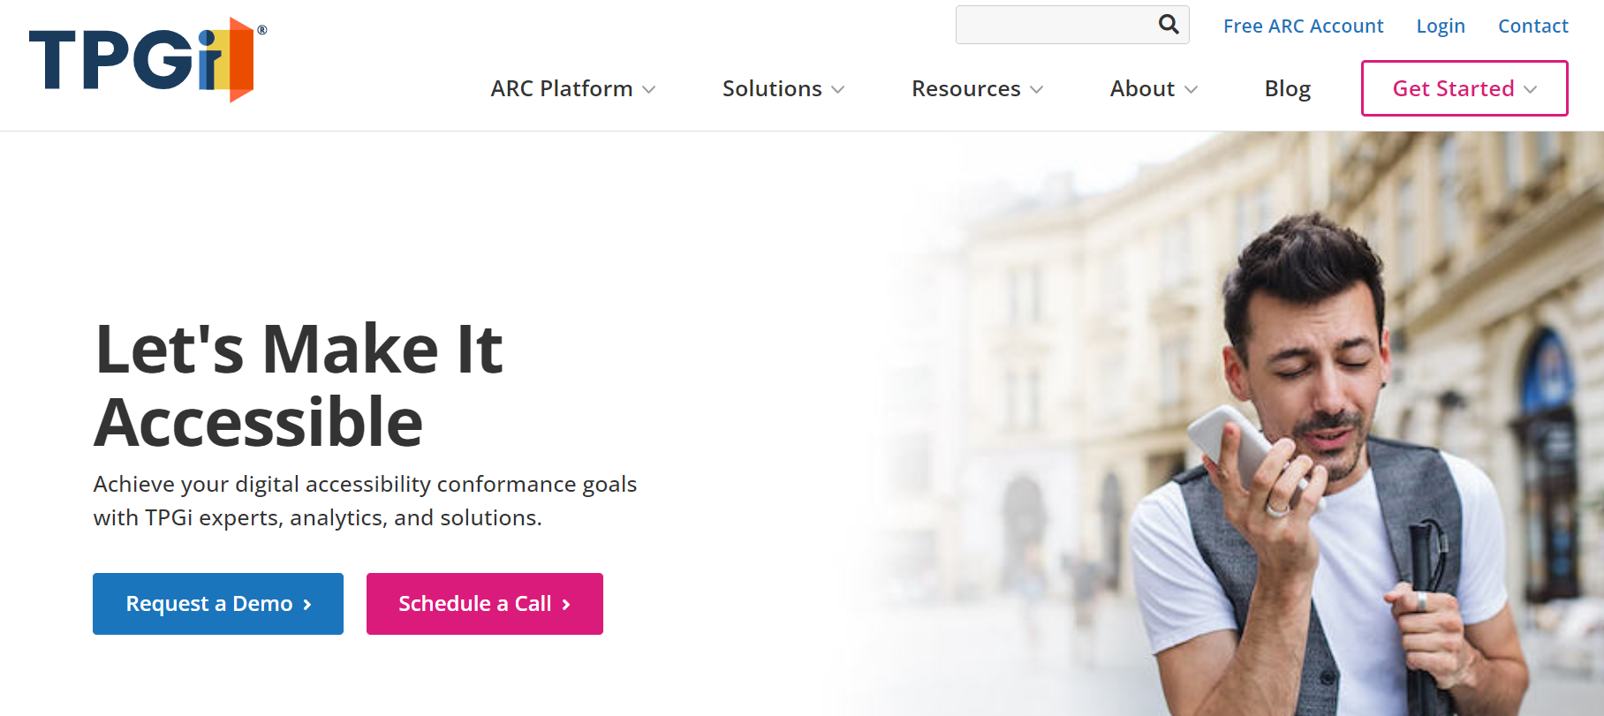
Before Monitoring, Plan for Testing

Slide 9
Break site into test samples

Slide 10
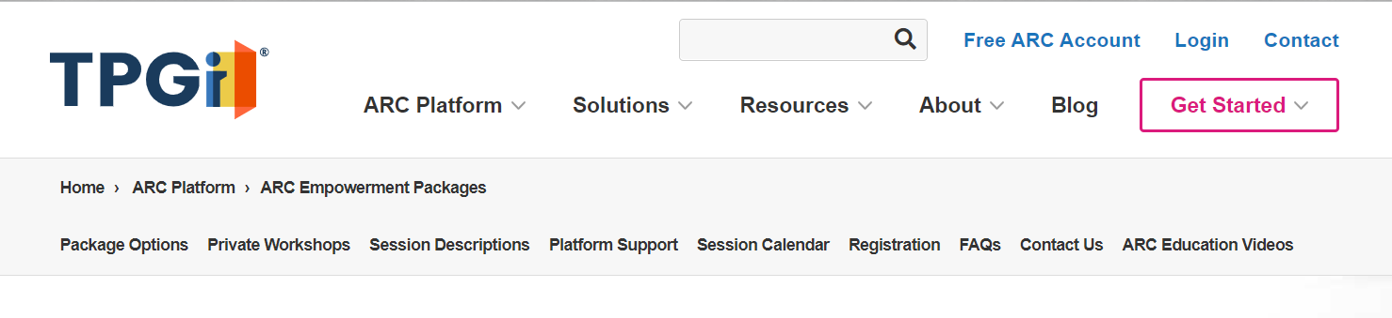
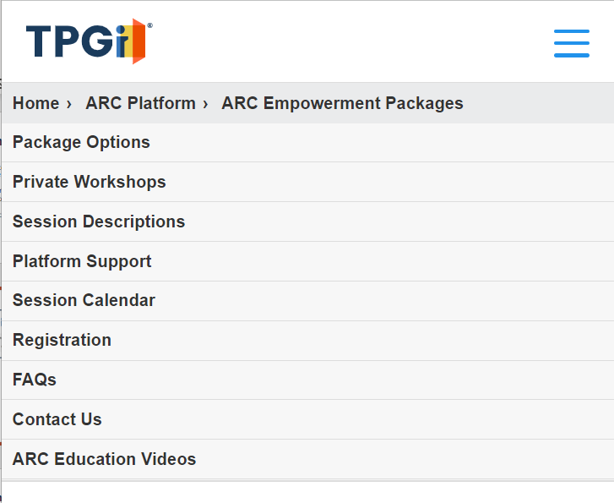
Testing includes all responsive breakpoints
Desktop layout
Mobile layout

Slide 11
How to Select a Representative Sample
Consider website structure and purpose
Include a range of content types – videos, forms, etc.
Select template components and page-specific content
Cover high-visibility, high-traffic user journeys
Each sample should be around the same size, level of effort to test

Slide 12
Why Select a Representative Sample
Not feasible to test every page
Work can be broken into manageable tasks
Easily delegate work to appropriate stakeholder, role
Facilitates communication and cross-collaboration

Slide 13
Group Related Accessibility Guidelines
Enables testing to be done by roles with the requisite skillset
Increases efficiency and reduces duplicative work - shifting between unrelated accessibility guidelines
Leads to full WCAG Coverage

Slide 14
Testing Page Structure/Navigation
1.3.1: Info & Relationships (A)
1.3.2: Meaningful Sequence (AA)
2.4.4: Link Purpose (In Context)

Slide 15
Testing Page Structure/Navigation
Does not require an engineering background
Does not require using Developer Tools
Requires only basic familiarity with a screen reader
Works with any browser – although best performed on a desktop Mac/PC

Slide 16
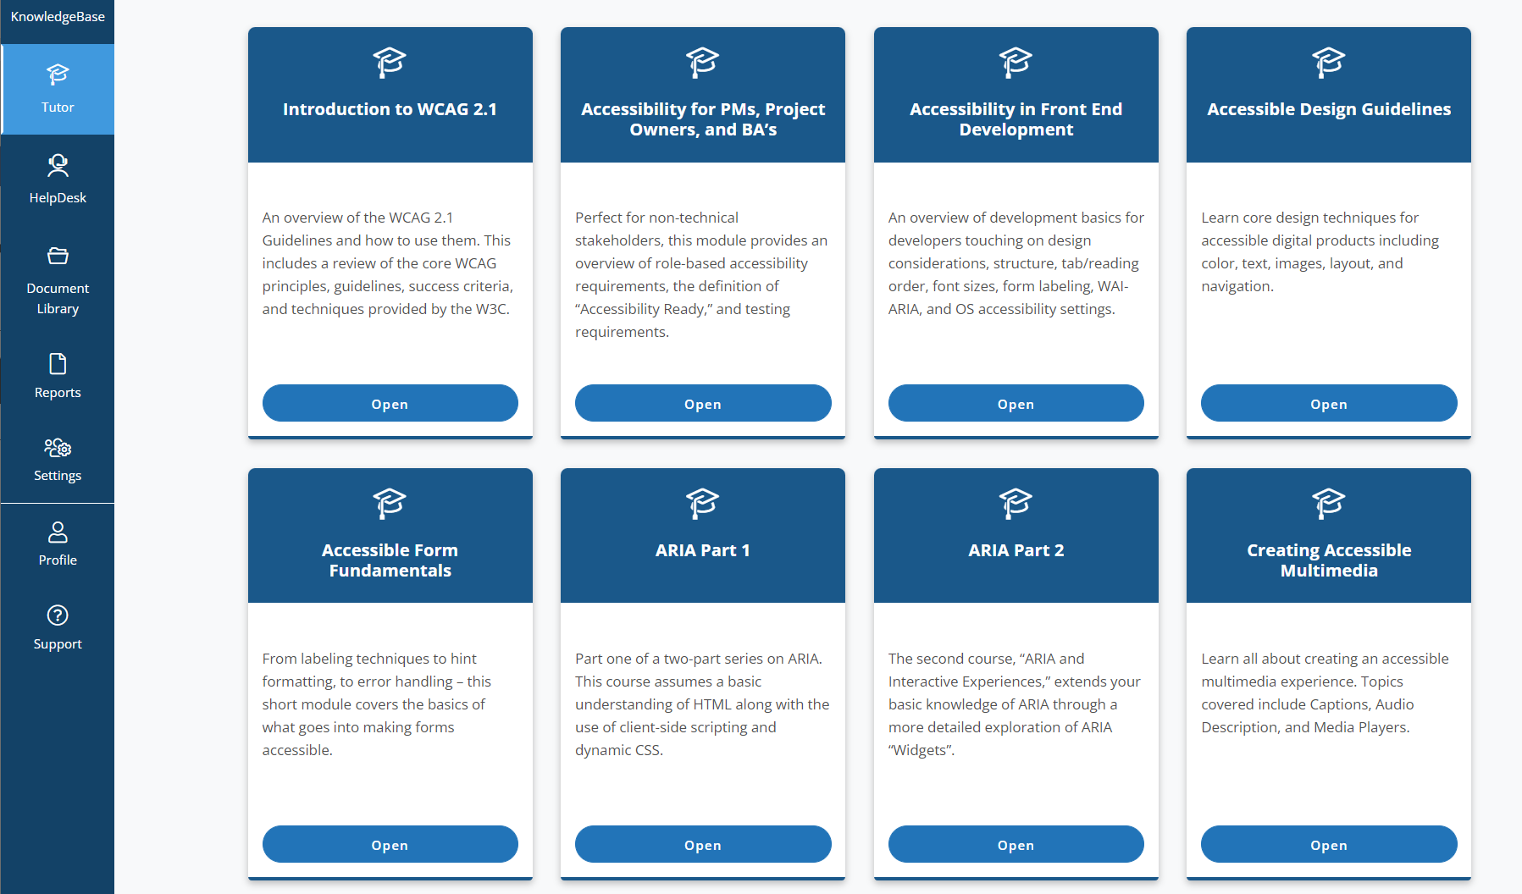
Accessibility Foundations
Consume Role-Based Trainings To Understand Fundamental Principles
For Page Structure Testing: Accessibility in Front End Development is recommended

Slide 17
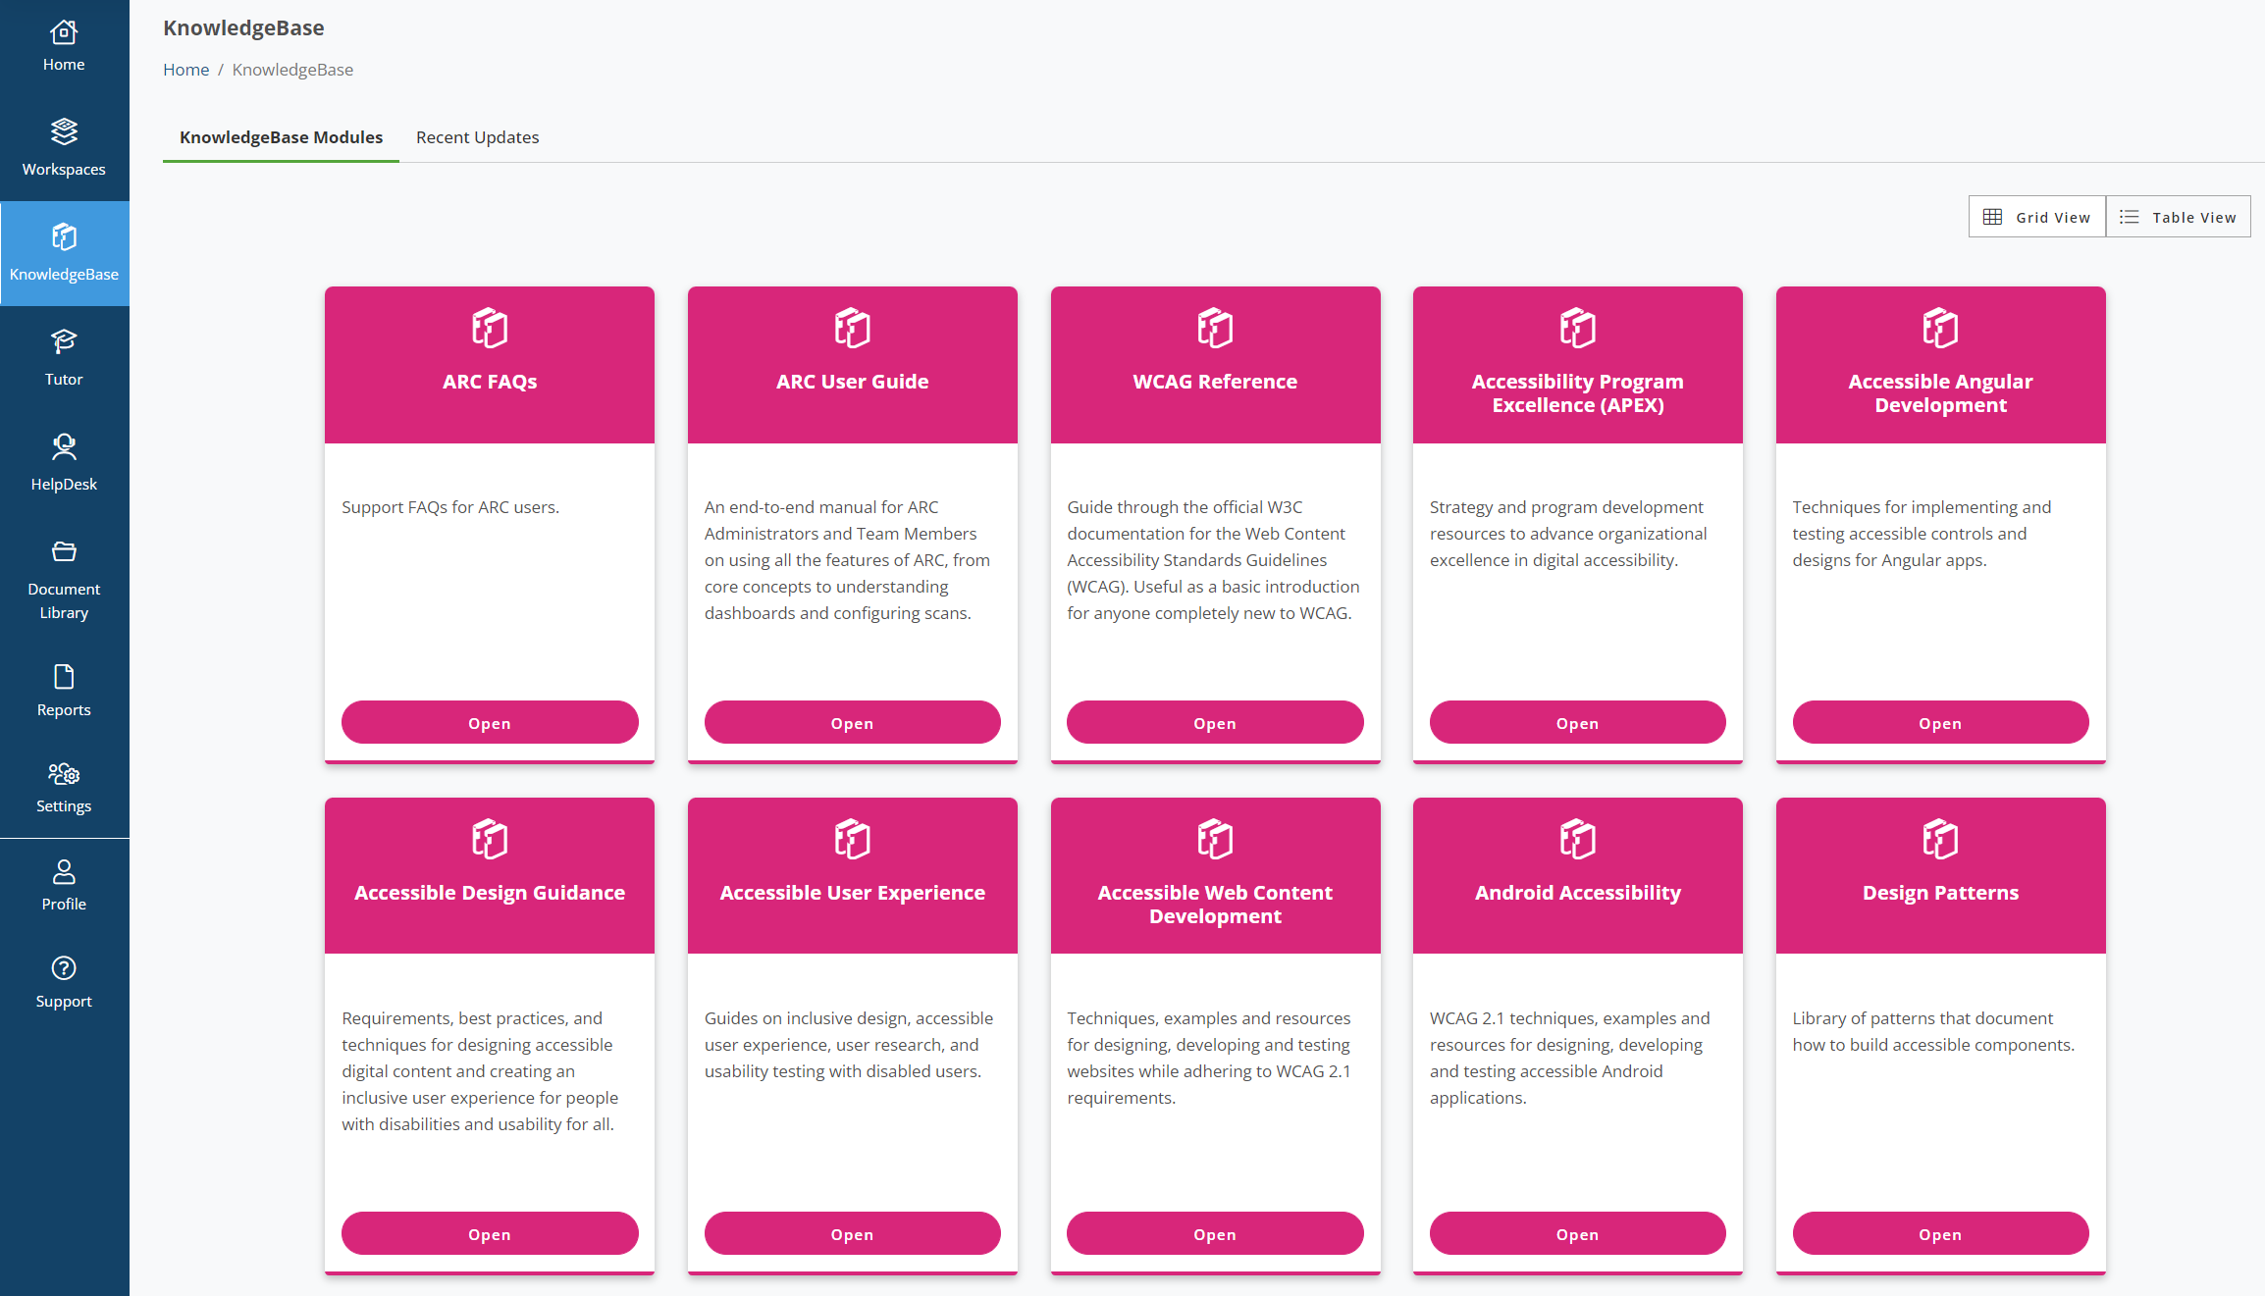
Tools and Resources
The main strength of testing with ARC is that each rule is paired with select resources from its expansive KnowledgeBase

Slide 18
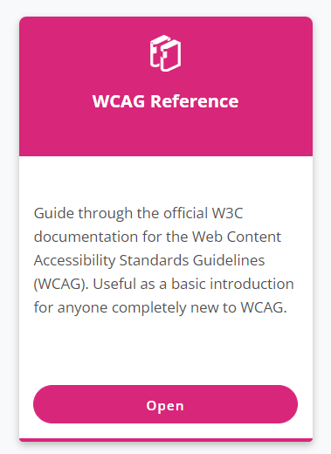
Understand
Understand The Significance of an Accessibility Guideline First
Summarizes Each WCAG Success Criteria
Including draft WCAG 2.2 Success Criteria

Slide 19
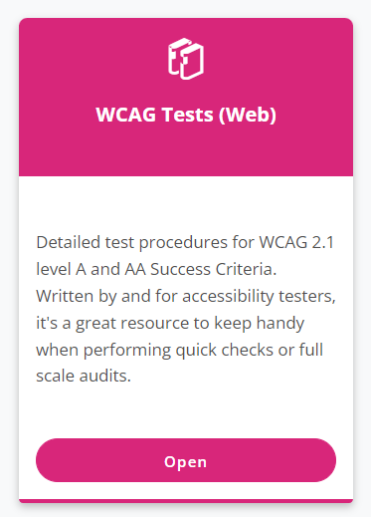
Test
Test An Issue To Determines Its Impact On User Experience
Provides Step-by-Step Manual Testing Procedure for Every Accessibility Guideline

Slide 20
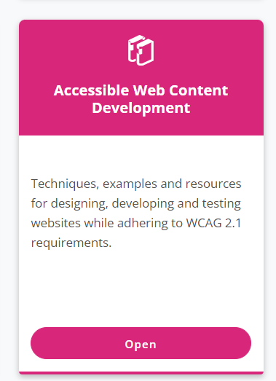
Solve
Solve an Issue with Battle-Tested, Clear Steps For Implementation
Detailed instructions with code samples, expected behaviors

Slide 21



Equip your team with testing tools
Screen Reader
ARC Toolkit
JAWS Inspect

Slide 22


How Screen Readers Work
Screen readers create a virtual buffer and programs like the browser expose information to the virtual buffer.
Virtual Buffer
User
with computer
equipped with screen reader
Browser
and its accessibility API’s
Web Page
and its author-defined HTML code

Slide 23
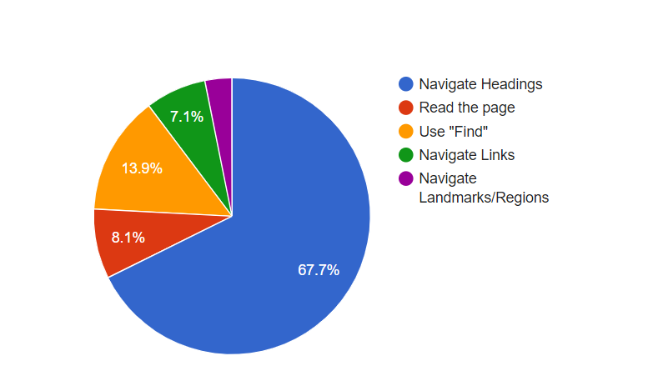
How Screen Readers Work
With the virtual buffer, screen reader users have methods for navigation far beyond what is available using the browser’s defaults
Primary method for finding Information on a lengthy webpage
Source: WebAIM Screen Reader Survey 2021

Slide 24
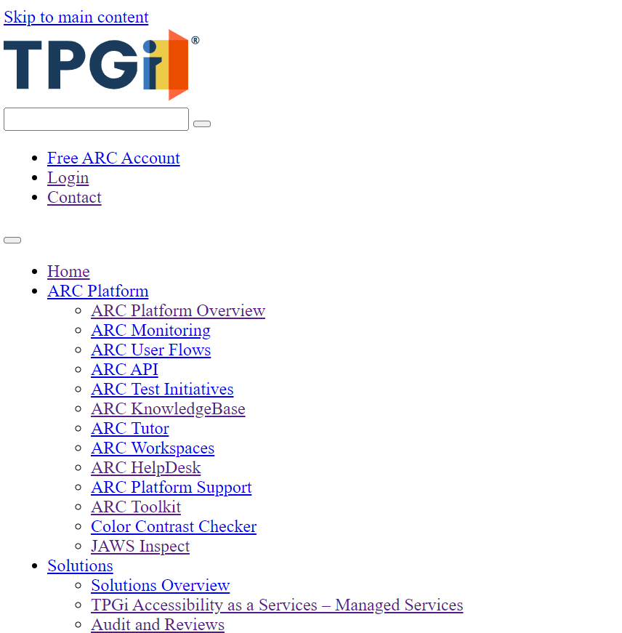
How Screen Readers Work
Screen readers strip away visual presentation and HTML elements which do not convey semantic meaning

Slide 25
How Screen Readers Work
With the virtual buffer, screen reader users have methods for navigation far beyond what is available using the browser’s defaults

Slide 26
Testing With JAWS
JAWS is the most robust screen reader. According to WebAIM’s non-scientific survey of screen reader users, JAWS is the primary screen reader used on the web.
Testing with JAWS most resembles the user experience for people that rely on screen readers to navigate the web.
If no license, JAWS has a 40 minute mode. However, the computer must be rebooted. But it is an option.
No special configuration required to use JAWS for testing.

Slide 27
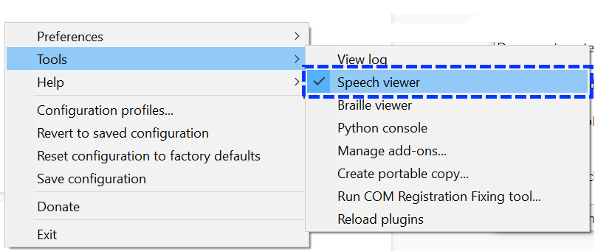
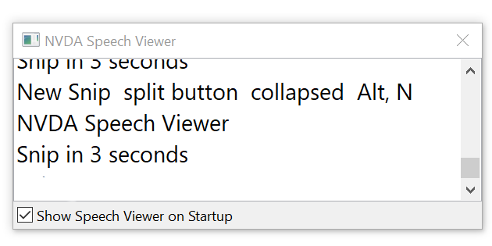
Testing with NVDA
See a live transcript of what is announced by the screen reader.
Use NVDA Modifier Key + N to open Context Menu
Expand Tools, activate the Speech Viewer
Use mouse wheel to increase the Speech Viewer text size.
NVDA Context Menu
NVDA Speech Viewer

Slide 28
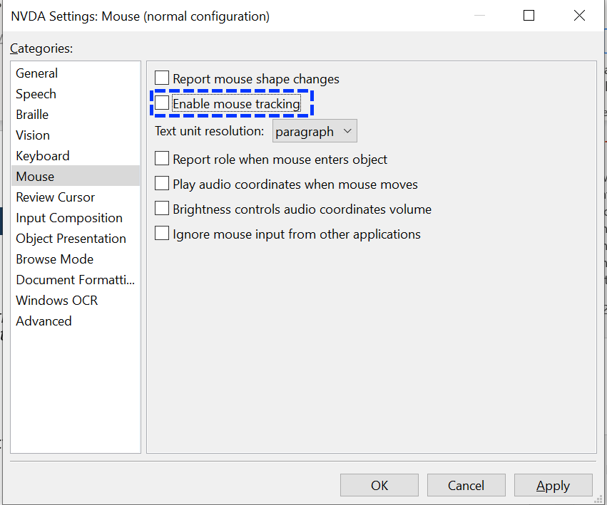
Testing with NVDA (cont.)
Turn off mouse tracking. Moving mouse over a control does not provide the full announcement and contrasts with screen reader user experience.
Use NVDA Modifier Key + N to open Context Menu
Expand Preferences > Select Settings
Select Mouse
Disable mouse tracking
NVDA Mouse Tracking

Slide 29
Testing with NVDA (cont.)
Have a visual indicator for the virtual cursor
Use NVDA Modifier Key + N to open Context Menu
Expand Preferences > Select Settings
Select Vision
Enable Vision Highlighting

Slide 30
Know the page-level navigation shortcuts
List Headings
List Links
List Landmarks
Usually some combination of Screen Reader Modifier/Action Key + F5, F6, F7

Slide 31
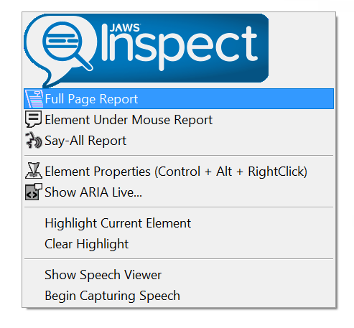
Testing with JAWS Inspect
Screen readers have a learning curve.
Easily (one-click!) generate a transcript of how JAWS reads a page.
Create a full page report or have a live log of how JAWS is reading the page as you navigate it yourself.

Slide 32
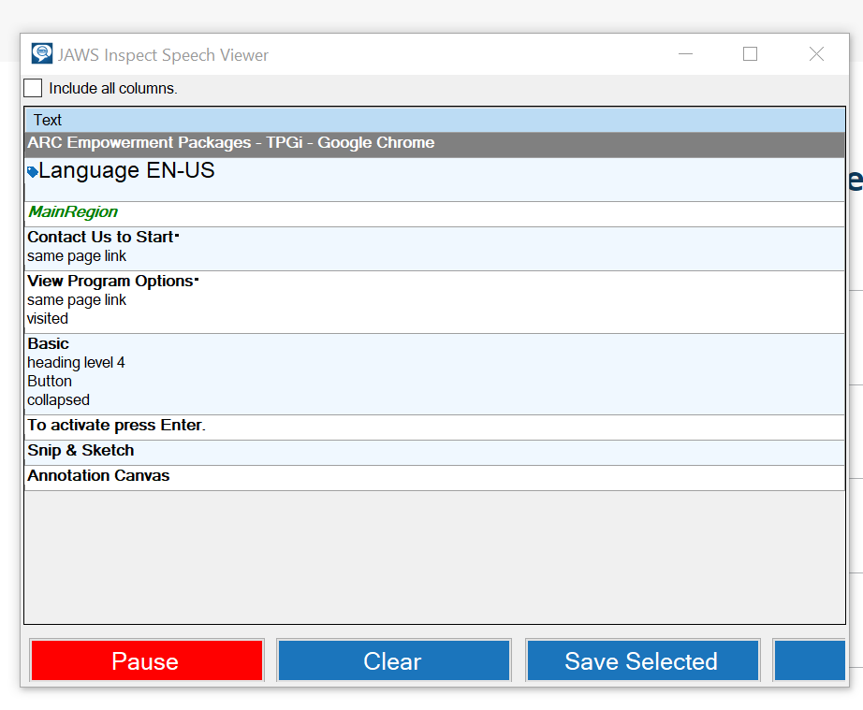
Testing with JAWS Inspect
JAWS Inspect Speech Viewer

Slide 33
ARC Toolkit
Free Chrome browser extension – easily scan anything appearing in your browser
Visually identifies headings, links, landmarks, and provides automated testing to help guide the manual testing experience

Slide 34
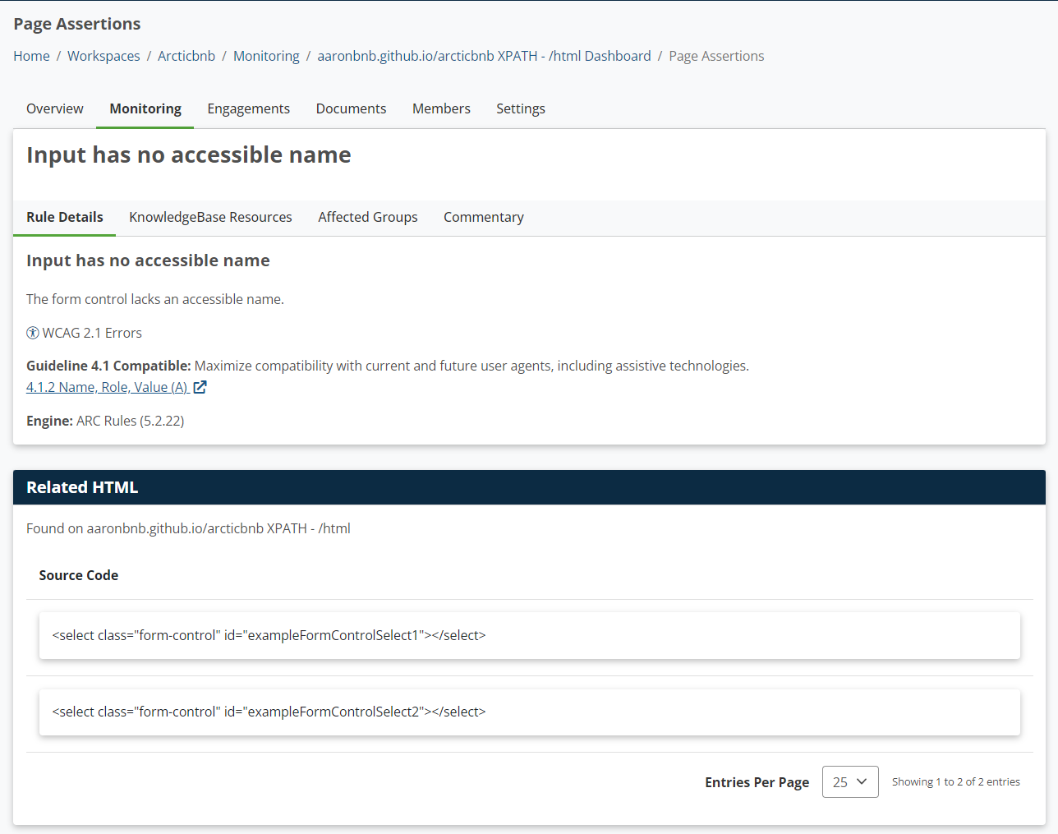
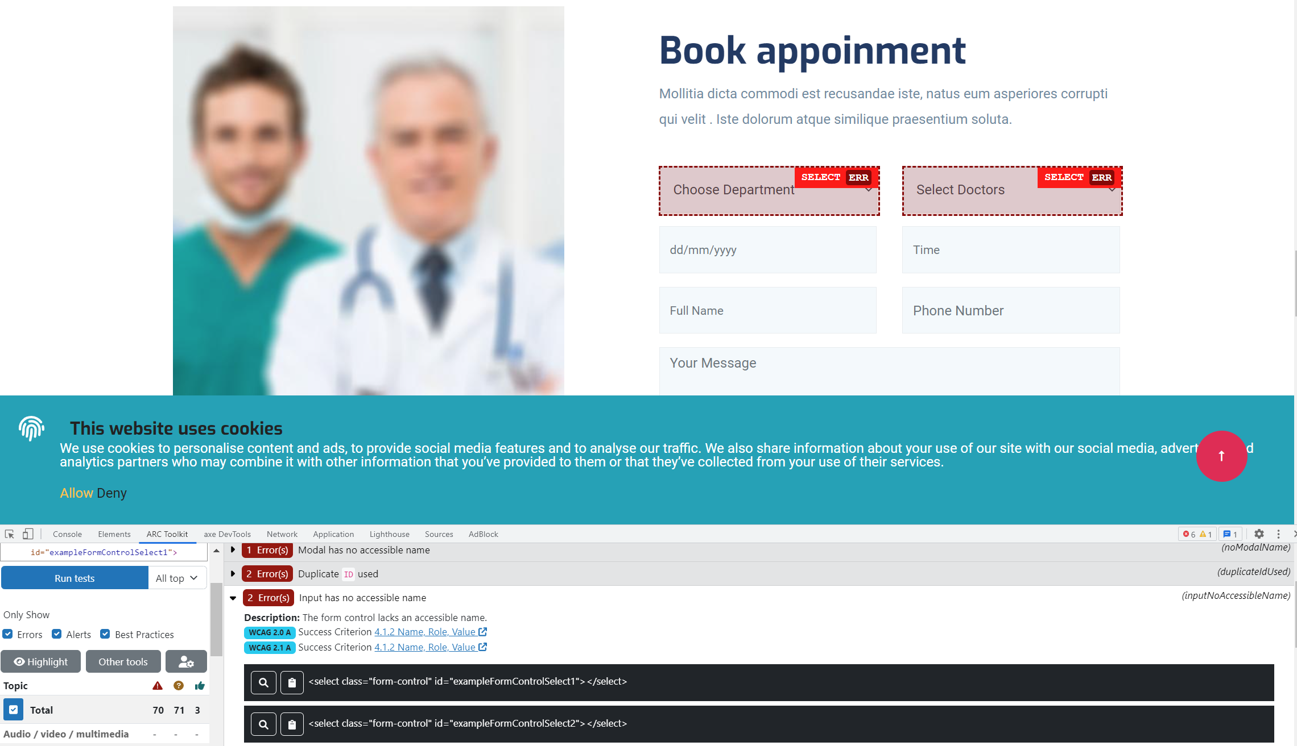
ARC Toolkit – its role in relation to ARC Monitoring
ARC Monitoring Display Test Results as HTML code snippet with access to ARC tools/resources
ARC Toolkit > Select Run Tests
Flags the element on the page
Visually inspect the element
Same issue

Slide 35
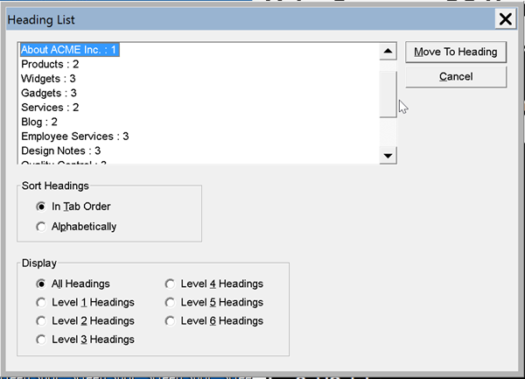
Headings
Elements List in JAWS
JAWS Modifier Key + F6

Slide 36
Headings
Headings can skip levels. Skipping levels is not a WCAG violation.
Multiple H1’s is not a WCAG violation.
Headings must follow a hierarchical structure, or more accurately, a logical structure.

Slide 37
Headings – what is a WCAG violation?
Visually prominent text that organizes content must be identified as a heading.
When headings are identified solely through CSS i.e. bold font styling, that is a WCAG violation

Slide 38
Landmarks
A site does not have to use landmarks.
Lack of landmarks is not inherently a WCAG violation.
However, it’s a WCAG violation if landmarks are not used logically.

Slide 39
Links
Open List of Links
Best practice: Link destination/purpose should be clear from link text alone
However, it’s only a WCAG violation if one cannot determine the link’s destination from the link’s immediately surrounding context.

Slide 40
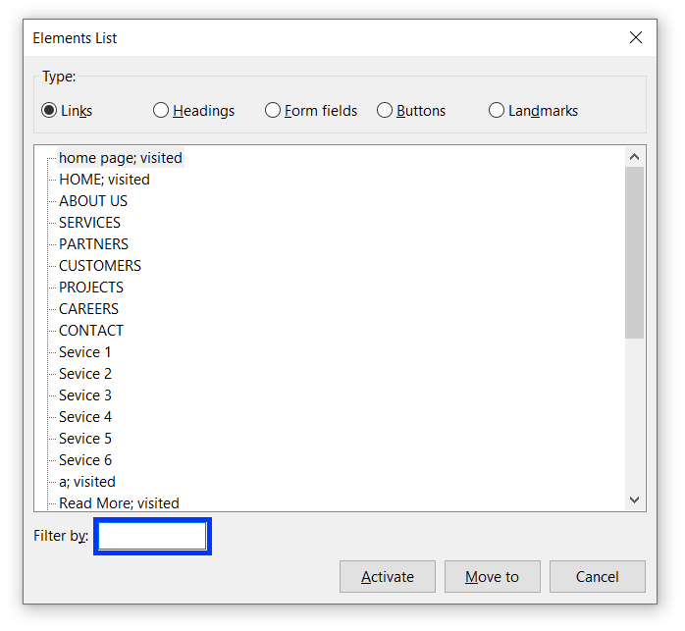
Links
Screen reader users having to open the page and go to a link and read around the link to understand the destination significantly reduces their ability to efficiently navigate the web.

Slide 41
Reading Order
Reading order does not have to match the page’s visual order.
However, the reading order must match how one would logically read through the page.
Use JAWS Inspect Say All Report or simply move down the page using the screen reader’s virtual cursor.

